Slide 1
Data Warehouse and BI Models

Slide 2
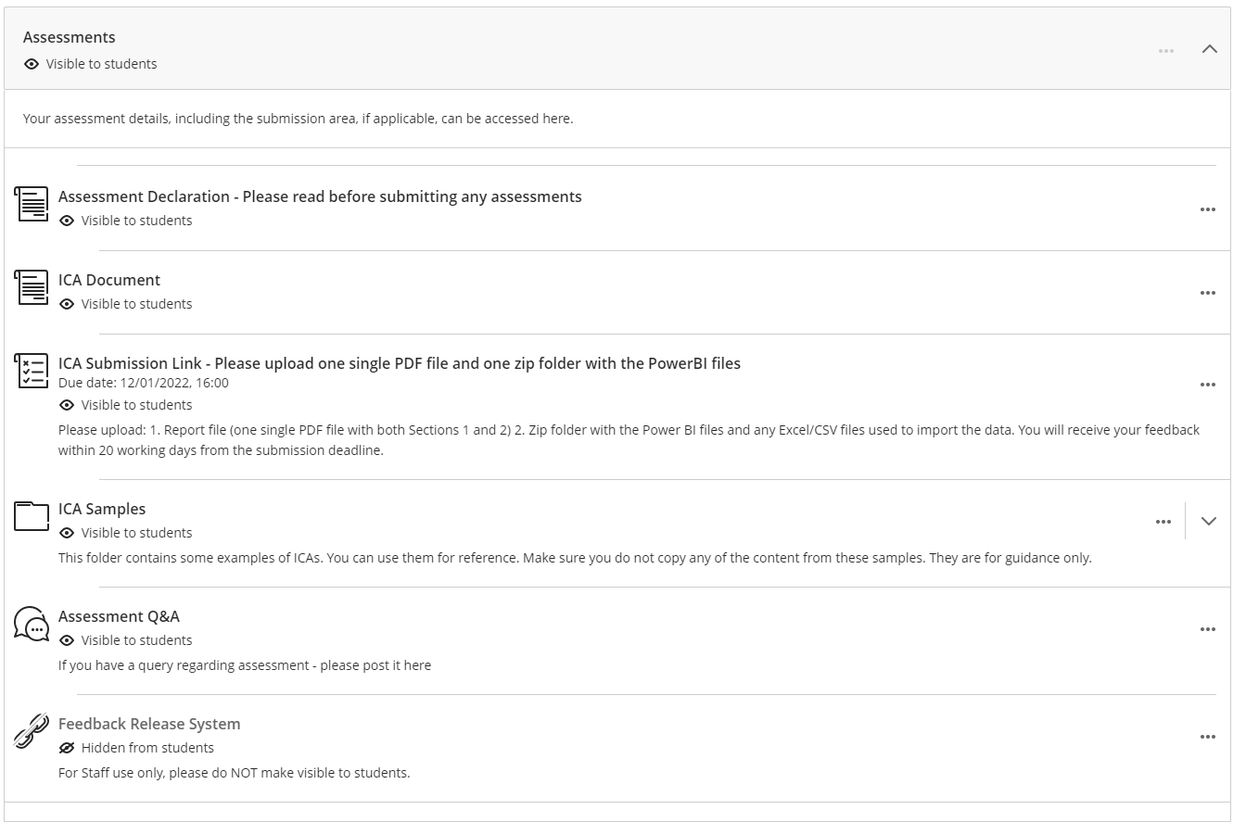
Don’t forget to check the Assessment Area on BB

Slide 3
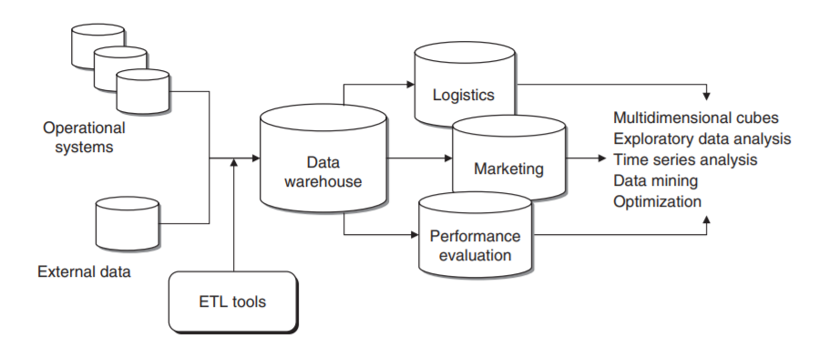
Outline
Data Types and Data Warehouse
BI Models

Slide 4
Data Warehouse
With a general introduction to Data

Slide 5
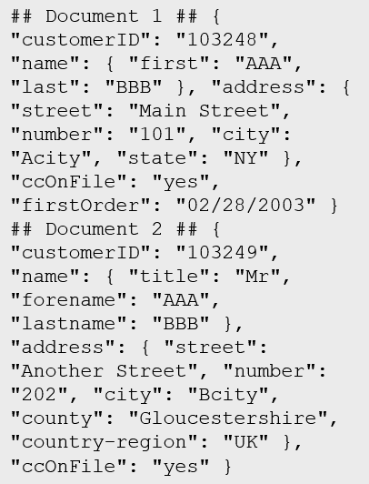
What is data?
Collection of facts, numbers, descriptions, objects , stored in a structured, semi-structured, unstructured way
Structured
Semi-structured
Unstructured
Table
Notes:
Instructor notes
Structured data is data that adheres to a schema, so all of the data has the same fields or properties. Structured data can be stored in a database table with rows and columns
Semi-structured data doesn't fit neatly into tables, rows, and columns. Instead, semi-structured data uses _tags_ or _keys_ that organize and provide a hierarchy for the data

Slide 6
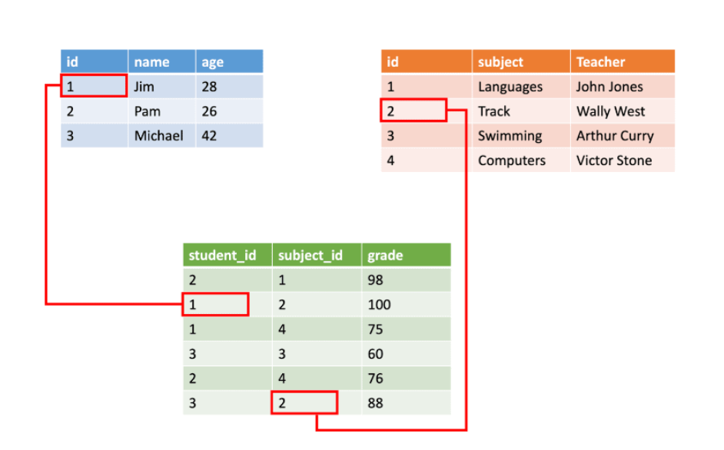
Structured Data
Customer
CustomerID | CustomerName | CustomerPhone
Account
CustomerID | Balance
5558 | 500
6023 | 2000
Account
CustomerID | Balance
5558 | 1000
6023 | 1500
Orders
OrderID | CustomerID | OrderDate
Transfers
TransactionID | FromAccount | ToAccount | Transaction Amount | OrderDate | TransactionDescription
Transfers
TransactionID | FromAccount | ToAccount | Transaction Amount | OrderDate | TransactionDescription
982801 | 6023 | 5558 | 500 | DD/MM/YY | Transfer 500 from account 6023 to account
BEGIN TRANSACTION
UPDATE Account
SET Balance = Balance -500
WHERE CustomerID=6023;
UPDATE Account
SET Balance = Balance +500
WHERE CustomerID=5558;
INSERT INTO Transfers (Fromaccount, ToAccount, TransactionAmount,TransactionDescription) VALUES (6023,5558,500,’Transfer 500 from account 6023 to account 5558)
COMMIT TRANSACTIONTransaction
Relational Tables
Notes:
Instructor notes
Ensure that students understand ACID:
*Atomicity* guarantees that each transaction is treated as a single *unit*, which either succeeds completely, or fails completely.
*Consistency* ensures that a transaction can only take the data in the database from one valid state to another.
*Isolation* ensures that concurrent execution of transactions leaves the database in the same state that would have been obtained if the transactions were executed sequentially.
*Durability* guarantees that once a transaction has been committed, it will remain committed even if there's a system failure such as a power outage or crash.

Slide 7
Semi-Structured
Entities
## Customer 1 ID: 1
Name: Mark Hanson
Telephone: [ Home: 1-999-9999999, Business: 1-888-8888888, Cell: 1-777- 7777777 ]
Address: [ Home: 121 Main Street, Some City, NY, 10110,
Business: 87 Big Building, Some City, NY, 10111 ]
## Customer 2 ID: 2
Title: Mr
Name: Jeff Hay
Telephone: [ Home: 0044-1999-333333, Mobile: 0044-17545-444444 ]
Address: [ UK: 86 High Street, Some Town, A County, GL8888, UK,
US: 777 7th Street, Another City, CA, 90111 ]
Semi-structured collections can have:
Multiple entities in the same collection or container with different fields
Have a different, non-tabular schema
Are often defined by labeling each field with the name it represents
Notes:
Instructor notes
Data doesn’t follow rules of relational data.
Because data can be loaded in its native form, it can be loaded quickly.
Very flexible and good for unknown data or queries.
Less good for known data structures and known queries.

Slide 8
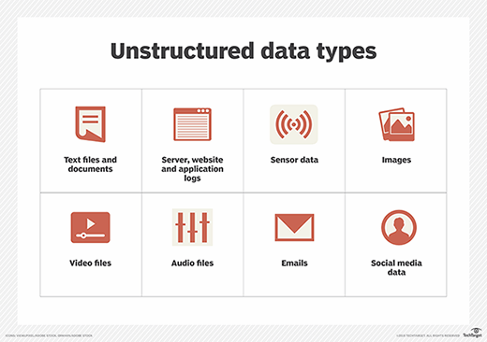
Unstructured Data
Notes:
Instructor notes
Data doesn’t follow rules of relational data.
Because data can be loaded in its native form, it can be loaded quickly.
Very flexible and good for unknown data or queries.
Less good for known data structures and known queries.

Slide 9

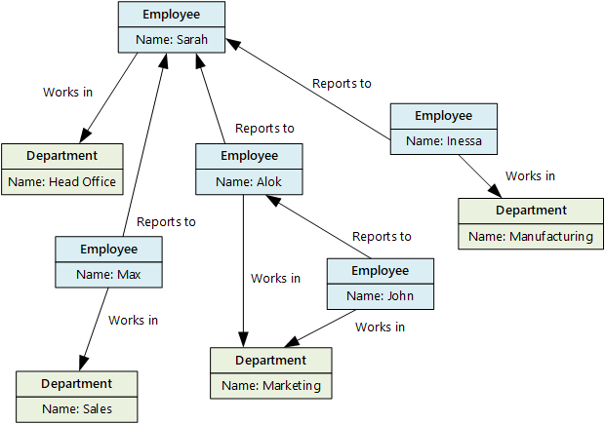

Example: graph database
Stores entities centric around relationships
Enables applications to perform queries traversing a network of nodes and edges
Notes:
Instructor notes
Graph databases enable you to store entities, but the main focus is on the relationships that these entities have with each other. A graph database stores two types of information: nodes that you can think of as instances of entities, and edges, which specify the relationships between nodes.

Slide 10
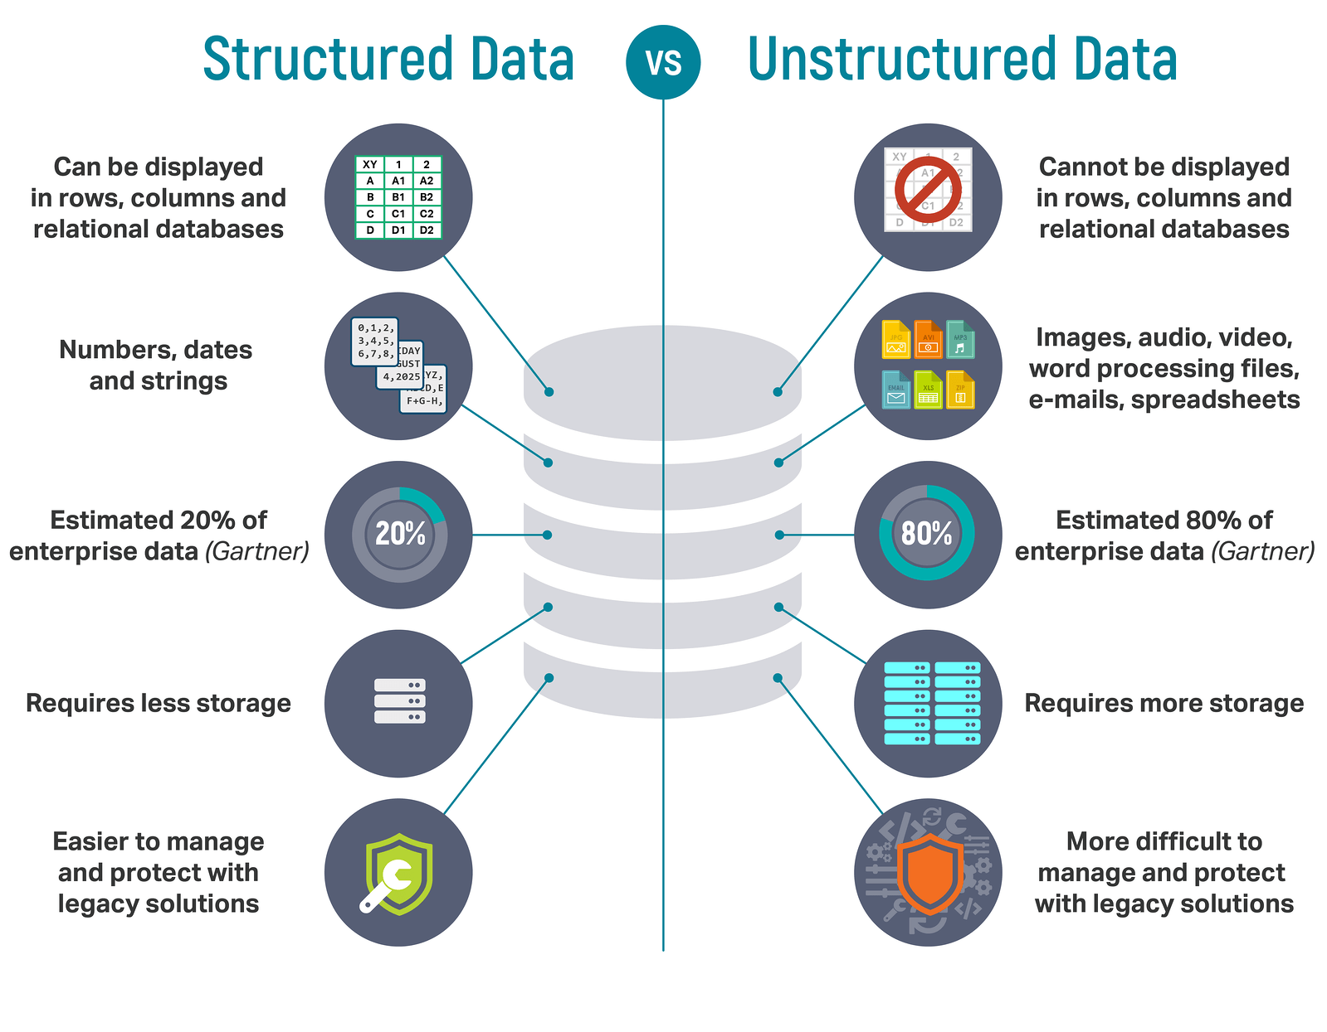

Slide 11
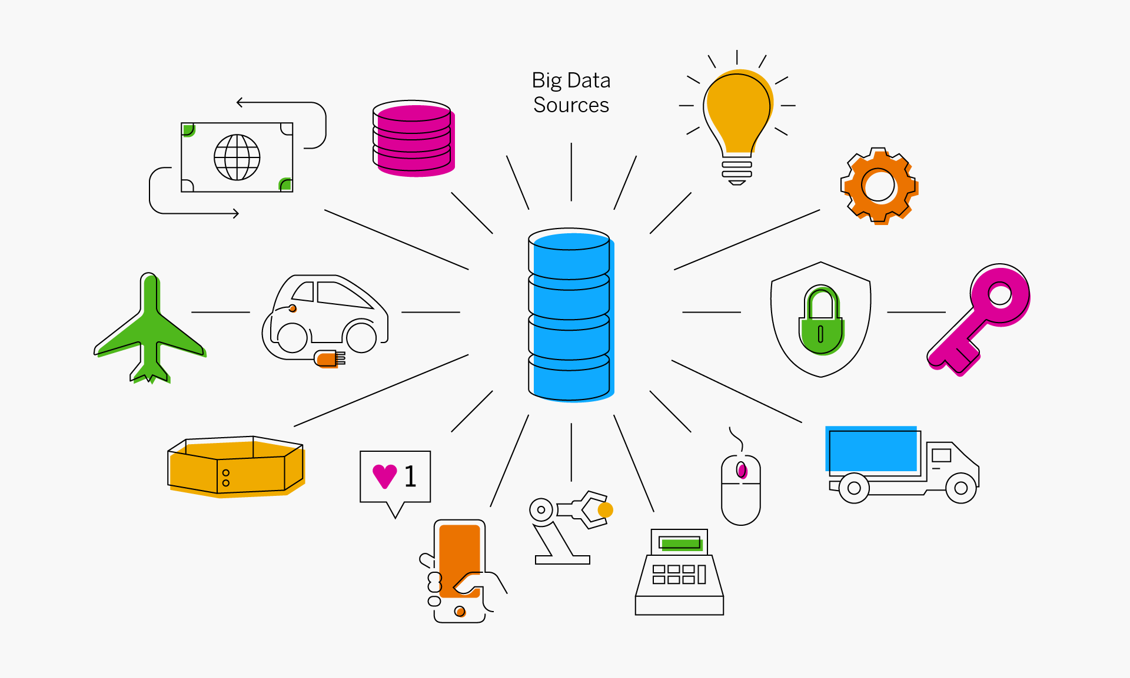
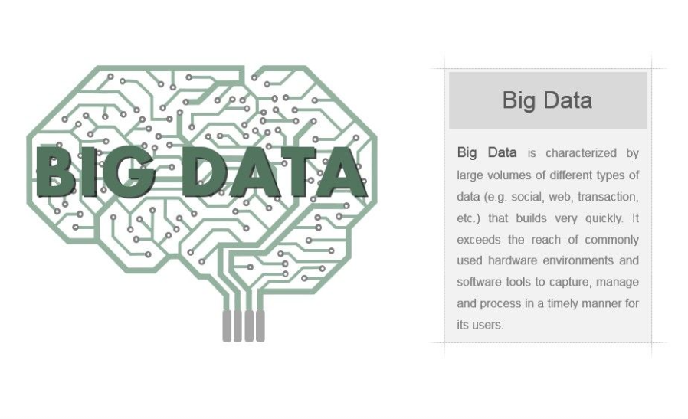

Slide 12

Knowledge check
How is data in a relational table organized?
Rows and Columns
Header and Footer
Pages and Paragraphs
Which of the following is an example of unstructured data?
An Employee table with columns Employee ID, Employee Name, and Employee Designation
Audio and Video files
A table within SQL Server database

Slide 13
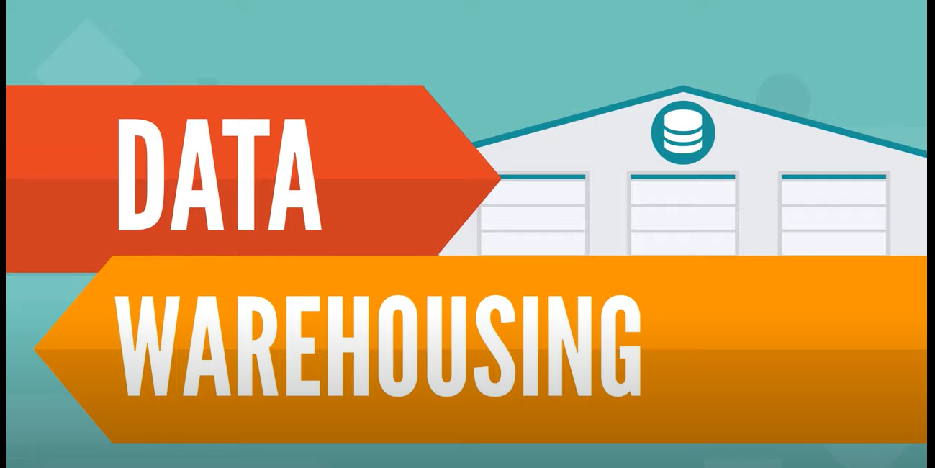
To store Big Data you need Modern data warehouse components
Things you need to Know about DW:
Single Source of Truth
5 Defining Features of DW
This video describes the components commonly used to create a data warehouse, and how data might flow through them.
https://www.youtube.com/watch?v=AHR_7jFCMeY
Notes:
Link: https://www.microsoft.com/videoplayer/embed/RE4A3RR

Slide 14
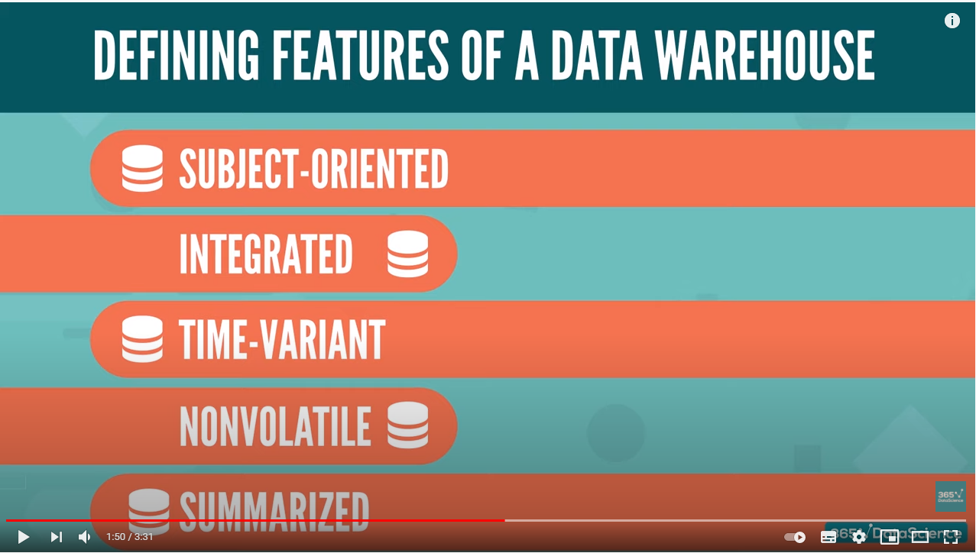
Defining Features of a Data Warehouse
Subject Oriented
Integrated
Time-Variant
NonVolatile
Summarised
???
???
???
???
???

Slide 15
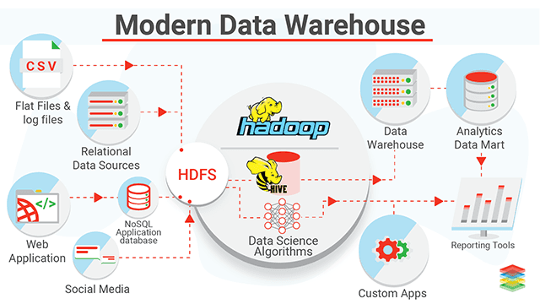
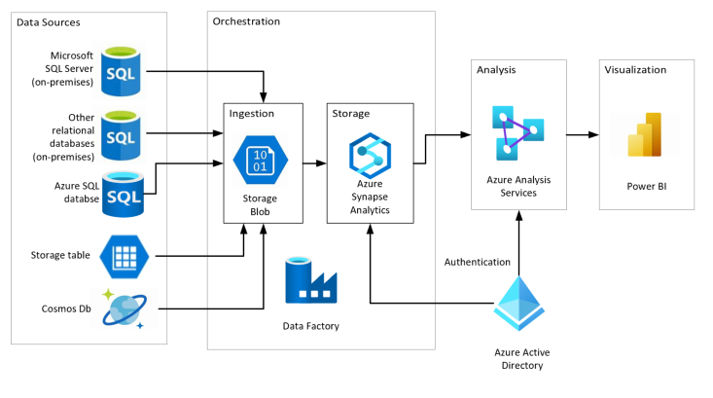
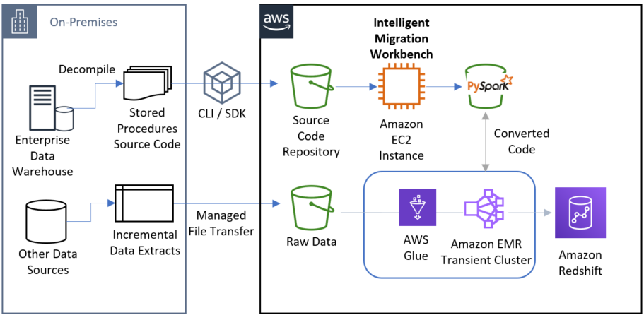




What is modern data warehousing?
Ingest & Prep
Model & Serve
Visualize
Azure Data Factory
Azure Synapse Analytics
(Data Warehouse)
Power BI
Code-free data transformation and ingestion from 90+ data integration connectors
Leader in the Magic Quadrant for Business Intelligence and Analytics Platforms*
Up to 14x faster and costs 94% less than other cloud providers
Azure Databricks (Data prep)
Up to 10x faster than vanilla Spark
Store
Azure Data Lake Storage
High performance data lake available in all 54 Azure regions
Notes:
Instructor notes
A modern data warehouse might contain a mixture of relational and non-relational data, including files, social media streams, and Internet of Things (IoT) sensor data.
Azure provides a collection of services you can use to build a data warehouse solution, including Azure Data Factory, Azure Data Lake Storage, Azure Databricks, Azure Synapse Analytics, and Azure Analysis Services.
You can use tools such as Power BI to analyze and visualize the data, generating reports, charts, and dashboards.

Slide 16

Data Load: Batch data/streaming data
Batch
Streaming
Notes:
Instructor notes
Batch processing
In batch processing, newly arriving data elements are collected into a group. The whole group is then processed at a future time as a batch.
Streaming
With streaming data newly arrived elements are processed in real-time
Differences between batch and streaming
- *Data Scope*: Batch processing can process all the data in the dataset. Stream processing typically only has access to the most recent data received, or within a rolling time window (the last 30 seconds, for example).
- *Data Size*: Batch processing is suitable for handling large datasets efficiently. Stream processing is intended for individual records or *micro batches* consisting of few records.
- *Performance*: The latency for batch processing is typically a few hours. Stream processing typically occurs immediately, with latency in the order of seconds or milliseconds. Latency is the time taken for the data to be received and processed.
- *Analysis*: You typically use batch processing for performing complex analytics. Stream processing is used for simple response functions, aggregates, or calculations such as rolling averages.

Slide 17
Combine batch and stream processing
Ingest & Prep
Model & Serve
Visualize
Azure Data Factory
Azure Synapse Analytics
(Data Warehouse)
Power BI
Logs (unstructured)
Code-free data transformation and ingestion from 90+ data integration connectors
Leader in the Magic Quadrant for Business Intelligence and Analytics Platforms*
Up to 14x faster and costs 94% less than other cloud providers
Media (unstructured)
Azure Databricks (Data prep)
Up to 10x faster than vanilla Spark
Files (unstructured)
Store
Azure Data Lake Storage
Business/custom apps (structured)
High performance data lake available in all 54 Azure regions
Notes:
The data sources on the left will include live data such as stock market data which will be streamed instantly.
There will also be data coming from historical sources such as past sales. This data could be loaded monthly.
A third type of data would be live sales. This can be streamed instantly as well as loaded as a batch into the historical sales data.
You should run through the paths that data can take including, for example:
Completely live data could come from a log, to Azure Data Factory to be prepped, to Synapse analytics to be modelled, to Power BI to be Visualized.
Live sales data could come from an app, to Azure Data Factory to be prepped, to Synapse analytics to be modelled, to Power BI to be Visualized.
Periodically sales data is ingested by Databricks and stored in Data Lake. This data is combined with live data by Synapse Analytics to compare live and historical data in Power BI.

Slide 18

Transactional vs analytical data stores
Online Transactional Processing (OLTP)
Online Analytical Processing (OLAP)
Customer
CustomerID | CustomerName | CustomerPhone
Orders
OrderID | CustomerID | OrderDate
Data is periodically loaded, aggregated and stored in a cube
Data is stored one transaction at a time
OLTP is good for many small updates that happen frequently
OLAP is good for large summarized queries that happen periodically.
Notes:
Instructor notes
It is important to understand the distinction between OLTP and OLAP.
OLTP is typically a live system. Updates are made transactionally, for example, an order is placed. Each individual order is stored in the OLTP system.
OLAP is an aggregated system. Data is imported (often from an OLTP system) and aggregated. The aggregation will typically occur at different levels allowing you to drill down or up, for example from a company summary, to a department summary, to an employee town summary. Because OLAP data is aggregated periodically, once the aggregation has been performed, queries which need the summaries that it contains are very fast.
OLTP is good for many small updates that happen frequently. OLAP is good for large summarized queries that happen periodically.

Slide 19





Analytical system
On-premises data
SQL Server, Oracle, fileshares, SAP
Data ingestion
Data storage
Data processing
Data visualization
Cloud data
Azure, AWS, GCP
SaaS data
Salesforce, Dynamics
Notes:
Instructor notes
Analytical workloads are typically read-only systems that store vast volumes of historical data or business metrics
Analytics can be based on a snapshot of the data at a given point in time, or a series of snapshots.
An example of analytical information is a report on monthly sales.
SaaS – Software as a service – Third Party resource. is a software distribution model in which a cloud provider hosts applications and makes them available to end users over the internet

Slide 20
Terminology check
Data
Structured (rows and tables)
Semi-structured (Entities)
Unstructured Data (Videos and Images)
Data Warehouse
Storage (Single version of Truth + 4 Defining Features)
Modern Datawarehouse (Cloud-based)
Batch and Stream processing
5
Transactional VS Analytical data stores
OLT
OLAP
Example of Analytical System
P
Anything wrong on this slide?
Can you spot it?

Slide 21
Business Intelligence Models
First Steps

Slide 22

Recap: What is Business Intelligence?
BI refers to computer-based techniques used in spotting, digging-out, and analysing business data
BI technologies provide historical, current, and predictive views of business operations
BI often aims to support better business decision-making

Slide 23
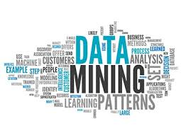
Why BI?
Tremendous amount of data
Low-cost data storage technologies
Free access to large amount of data
High dimensionality of data
Many dimensions to be combined together
High complexity of data
Time-series data, temporal data, sequence data
Spatial, spatiotemporal, multimedia, text and Web data

Slide 24
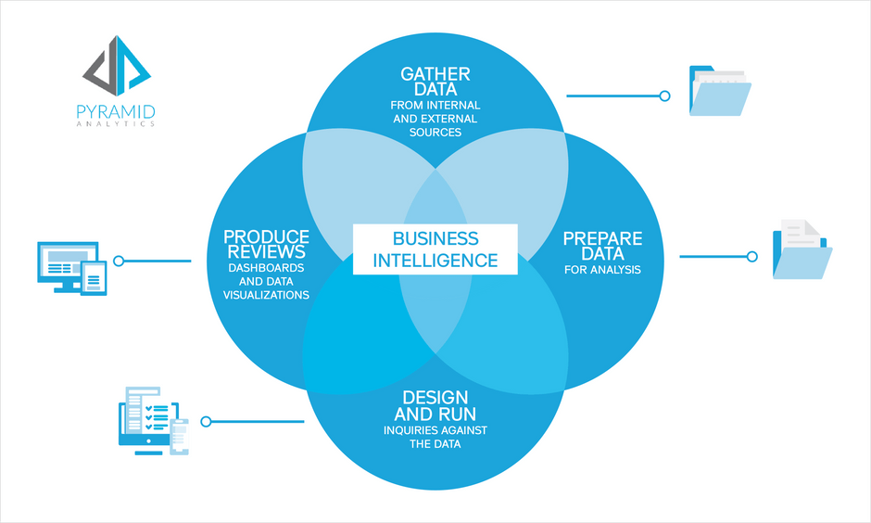
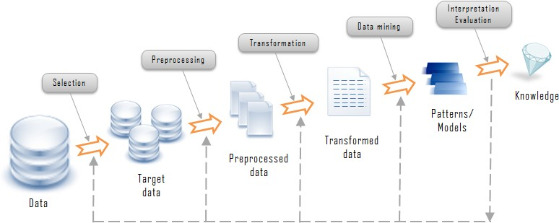
The main steps of BI
Knowledge Discovery Process
Data mining is the process of discovering patterns in large data sets involving methods at the intersection of machine learning, statistics, and database systems.

Slide 25
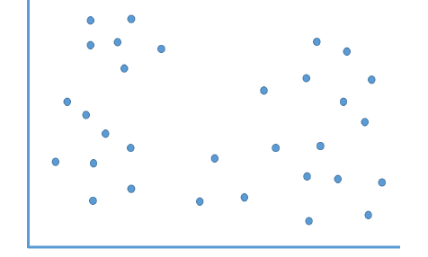
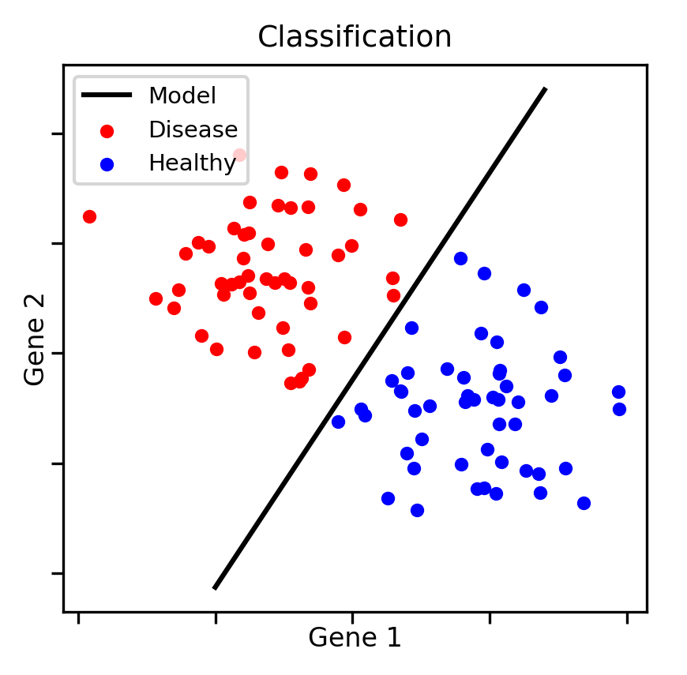
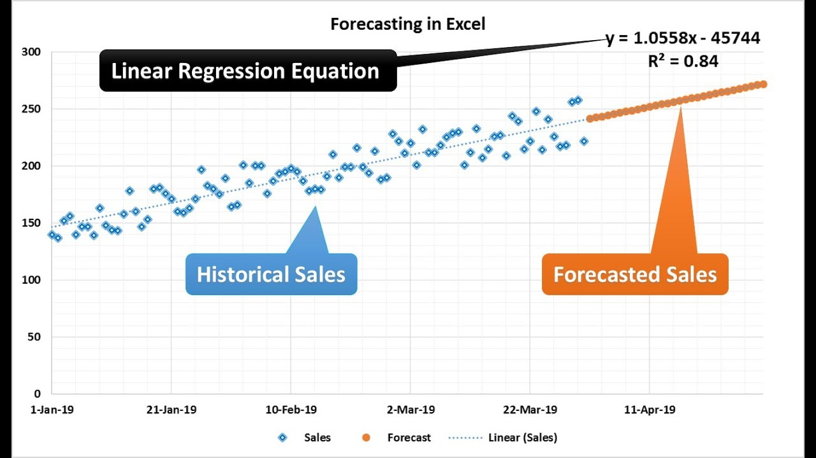
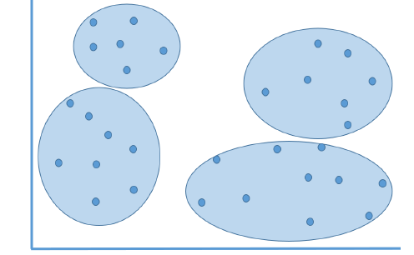
BI Analysis Models
Classification of observations to classes, e.g. Healthy or Disease classes based on genetic factors (you know the classes).
Prediction is similar, but instead of assignment to classes, we try to predict the value of a numerical variable, e.g. amount of credit card purchase (regression).
Association\Clustering rules or affinity analysis tells what is associated with the observations. Recommender systems (e.g. amazon.com) use association rules (you don’t know the classes).

Slide 26
Example1: Customer behaviour
Classification models can be used to determine whether a customer is likely to purchase more items or not.
If the classification model predicts a greater likelihood that they are about to make more purchases, then you might want to send them promotional offers and discounts accordingly.
Or if it has been determined that they will probably fall off of their purchasing habits soon, maybe save them for later by making their information readily available.
You need to send promotional offers to your customers, but you want to send them to the ones that are more likely to buy/respond to the offers.
To classify customers into two categories based on their buying patterns, web store browsing patterns etc., which model would you use?
Clustering
Prediction\Regression

Slide 27
Example: Business Network Traffic
Clustering models can be used to used to group together characteristics of the traffic sources.
When the clusters are created, you can then classify the traffic types (spam-related or bot-generated).
By having precise information on traffic sources, you are able to grow your site and plan capacity effectively.
You want to understand the different types of traffic coming to your website.
You will use this information to understand which traffic might be spam or coming from bots, but you are not sure how many classes/types of network traffic there can be. Which model would you use?
Clustering
Prediction\Regression
Clustering

Slide 28
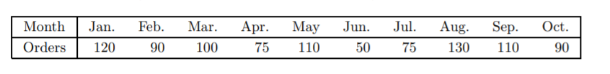
Example : Drivers Required
The Instant Paper Clip Office Supply Company sells and delivers office supplies to companies, schools, and agencies within a 50-mile radius of its warehouse.
The manager of the company wants to be certain that enough drivers and vehicles are available to deliver orders promptly and that they have adequate inventory in stock.
The manager wants to be able to forecast the demand for deliveries during the next month using the data below. Which model would you use?
Prediction models can be used to forecast the number of orders placed next month and determine the required number of drivers.
Prediction\Regression
Prediction\Regression
Clustering

Slide 29
Business Intelligence Architectures

Slide 30
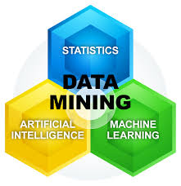
Applications of BI
Financial Data Analysis (classification of customers for targeted marking, loan payment prediction)
Retail Industry (customer buying patterns)
Telecommunication Industry (identifying the telecommunication patterns, improve quality of service)
Biological Data Analysis (discovery of structural patterns and analysis of genetic networks and protein pathways)
Subtypes:
Text mining: mining of patterns from text
Web mining: discovering patterns from the web
Notes:
Financial Data Analysis
The financial data in banking and financial industry is generally reliable and of high quality which facilitates systematic data analysis and data mining. Some of the typical cases are as follows −
Design and construction of data warehouses for multidimensional data analysis and data mining.
Loan payment prediction and customer credit policy analysis.
Classification and clustering of customers for targeted marketing.
Detection of money laundering and other financial crimes.
Retail Industry
Data Mining has its great application in Retail Industry because it collects large amount of data from on sales, customer purchasing history, goods transportation, consumption and services. It is natural that the quantity of data collected will continue to expand rapidly because of the increasing ease, availability and popularity of the web.
Data mining in retail industry helps in identifying customer buying patterns and trends that lead to improved quality of customer service and good customer retention and satisfaction. Here is the list of examples of data mining in the retail industry −
Design and Construction of data warehouses based on the benefits of data mining.
Multidimensional analysis of sales, customers, products, time and region.
Analysis of effectiveness of sales campaigns.
Customer Retention.
Product recommendation and cross-referencing of items.
Telecommunication Industry
Today the telecommunication industry is one of the most emerging industries providing various services such as fax, pager, cellular phone, internet messenger, images, e-mail, web data transmission, etc. Due to the development of new computer and communication technologies, the telecommunication industry is rapidly expanding. This is the reason why data mining is become very important to help and understand the business.
Data mining in telecommunication industry helps in identifying the telecommunication patterns, catch fraudulent activities, make better use of resource, and improve quality of service. Here is the list of examples for which data mining improves telecommunication services −
Multidimensional Analysis of Telecommunication data.
Fraudulent pattern analysis.
Identification of unusual patterns.
Multidimensional association and sequential patterns analysis.
Mobile Telecommunication services.
Use of visualization tools in telecommunication data analysis.
Biological Data Analysis
In recent times, we have seen a tremendous growth in the field of biology such as genomics, proteomics, functional Genomics and biomedical research. Biological data mining is a very important part of Bioinformatics. Following are the aspects in which data mining contributes for biological data analysis −
Semantic integration of heterogeneous, distributed genomic and proteomic databases.
Alignment, indexing, similarity search and comparative analysis multiple nucleotide sequences.
Discovery of structural patterns and analysis of genetic networks and protein pathways.
Association and path analysis.
Visualization tools in genetic data analysis.

Slide 31
Task for you: Retention in the mobile phone industry
The marketing manager of a mobile phone company realizes that a large number of customers are discontinuing their service, leaving her company in favour of some competing provider.
Suppose that the marketing manager can rely on a budget adequate to pursue a customer retention campaign aimed at 2000 individuals out of a total customer base of 2 million people.
Hence, the question naturally arises of how she should go about choosing those customers to be contacted so as to optimize the effectiveness of the campaign. In other words, how can the probability that each single customer will discontinue the service be estimated so as to target the best group of customers and thus reduce churning and maximize customer retention?
How would you choose these customers?

Slide 32
Example: Retention in the mobile phone industry
The marketing manager of a mobile phone company realizes that a large number of customers are discontinuing their service, leaving her company in favour of some competing provider.
Suppose that the marketing manager can rely on a budget adequate to pursue a customer retention campaign aimed at 2000 individuals out of a total customer base of 2 million people.
Hence, the question naturally arises of how she should go about choosing those customers to be contacted so as to optimize the effectiveness of the campaign. In other words, how can the probability that each single customer will discontinue the service be estimated so as to target the best group of customers and thus reduce churning and maximize customer retention?
By knowing these probabilities, the target group can be chosen as the 2000 people having the highest churn likelihood among the customers of high business value.
Without the support of advanced mathematical models and data mining techniques, it would be arduous to derive a reliable estimate of the churn probability and to determine the best recipients of a specific marketing campaign.

Slide 33
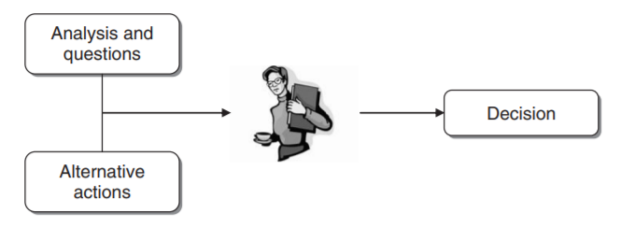
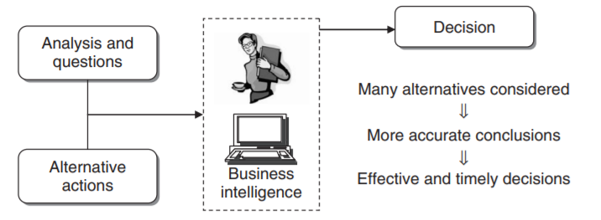
Example: Retention in the mobile phone industry

Slide 34


Quizzes
https://quizizz.com/admin/quiz/633188c0bd862d001d55c4bf

Slide 35

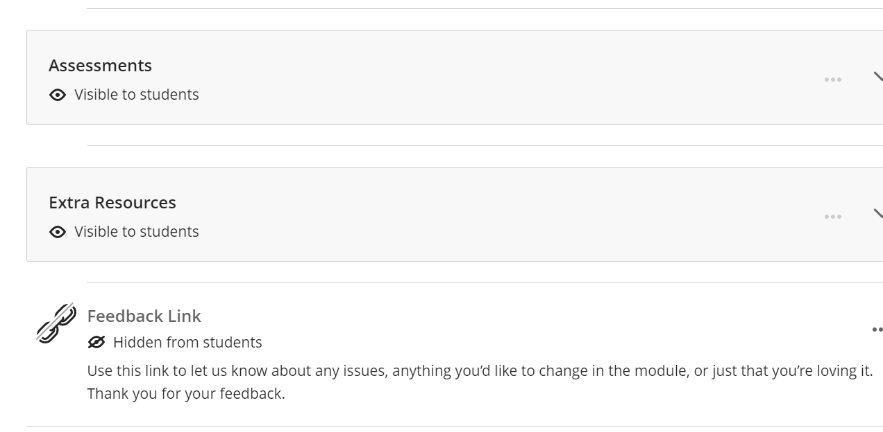
Today’s Key Concepts
Quiz time?
Quizzis!
Data Types and Modern Data Warehouse
BI Models
Questions?
a.occhipinti@tees.ac.uk
We’d love to hear your feedback!
Use the link on BB to let us know about any issues, anything you’d like to change in the module, or just that you’re loving it!

Slide 36

Extra Resources – Summary Video
https://www.youtube.com/watch?v=hDJdkcdG1iA

